Slide 1

Introduction to Cloud Computing
Module Number: 01
Module Name: Fundamentals of Cloud Computing
Version Code: CC1
Released Date: 18-Jul-2018

Slide 2
Fundamentals of Cloud Computing
AIM:
The aim of this module is to introduce students to the basics of cloud computing.
2

Slide 3
Introduction to Cloud Computing
Objectives:
The objectives of this module are:
Explain Cloud Computing and the need for cloud.
Outline the history of Cloud Computing.
Describe the various cloud deployment models.
Explain the evolution of data centres into private clouds.
Explain the business value of Cloud Computing.
2

Slide 4
Introduction to Cloud Computing
Outcomes:
At the end of this module, you are expected to:
Explain Cloud Computing and its advantages.
Describe cloud deployment models.
Determine the evolution of data centres into private clouds.
Recognize the business applications of cloud.
2

Slide 5
Introduction to Cloud Computing
Contents
Cloud Computing
Evolution of Cloud Computing
Characteristics of Cloud Computing
Advantages and Disadvantages of Cloud Computing
Cloud Deployment Models
Data Centres and Private Cloud
Business value in Cloud Computing
2

Slide 6
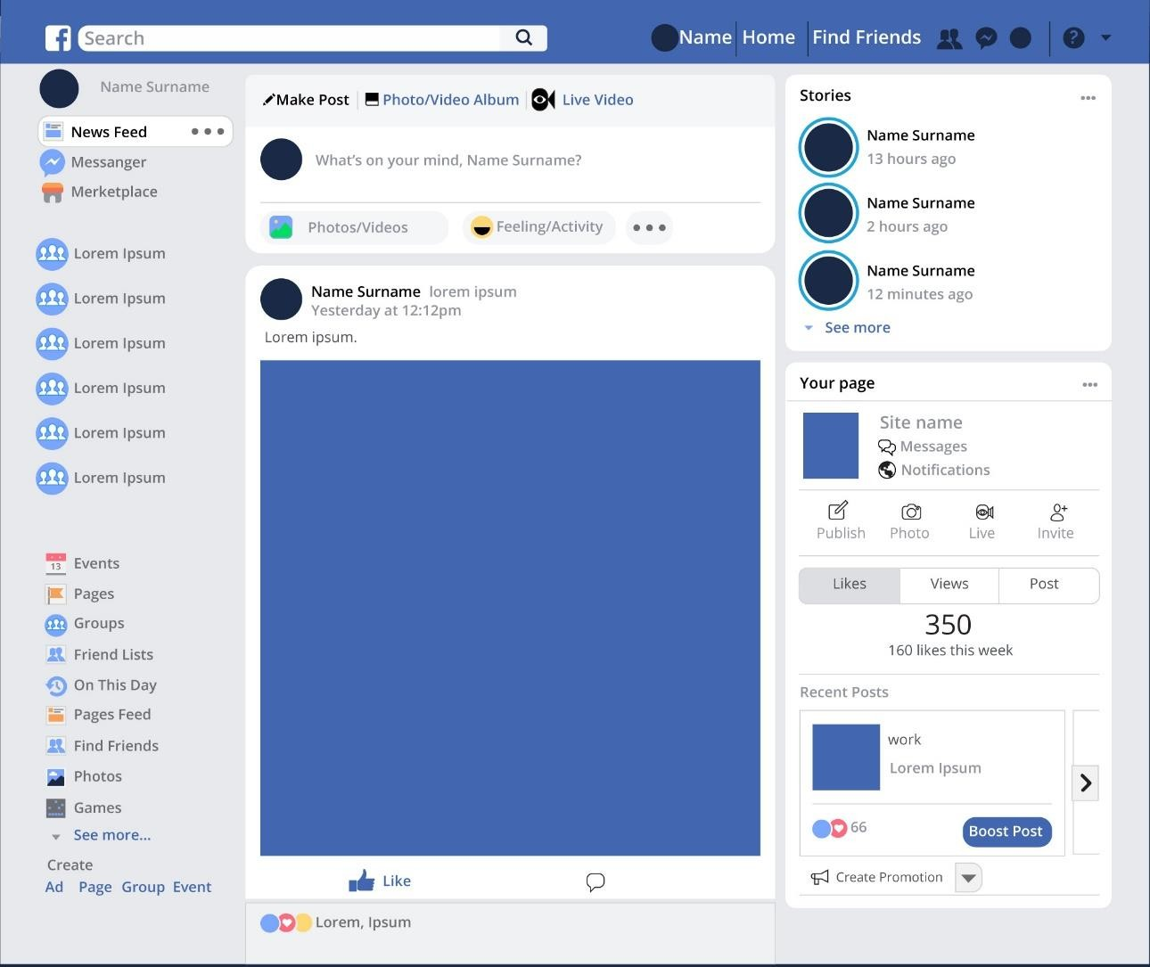
Introduction to Cloud Computing
Have you uploaded photos and videos on Facebook?
2

Slide 7


Introduction to Cloud Computing
Have you accessed the photos that you uploaded on Facebook in the past?
Where are the photos and videos we uploaded on Facebook stored?
2

Slide 8

Introduction to Cloud Computing
All the data are stored on Facebook servers located all across the globe.

Slide 9

Introduction to Cloud Computing
Similarly, we access Gmail, LinkedIn and other social media applications.
All we need is a password and if we can get to the internet through any device we can access our data.
So, there is no need to store anything?
No.

Slide 10
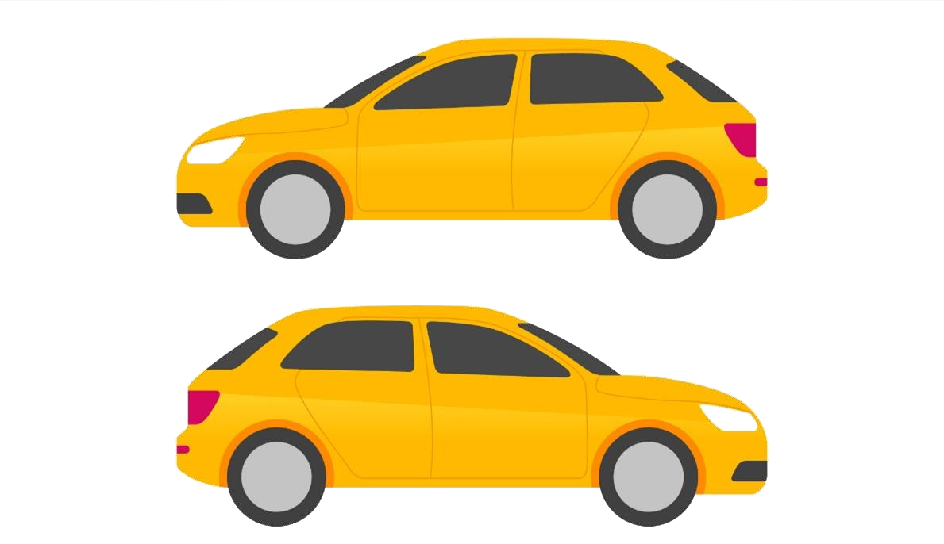
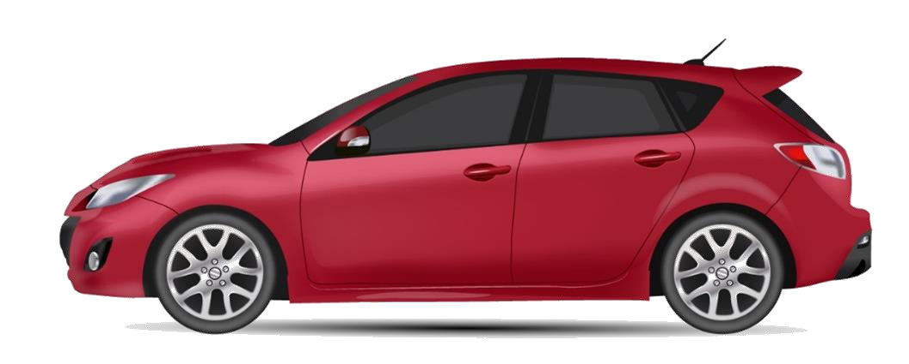
Introduction to Cloud Computing
To understand why cloud computing is needed, consider this as an example; we all have used Uber or Ola services at least once.
What is the advantage of using these services over buying a car?
OLA
VS.
Own car
UBER

Slide 11
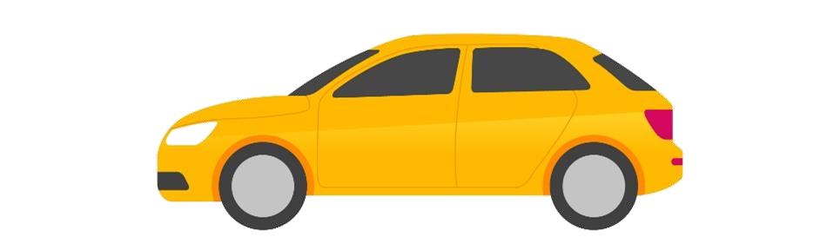
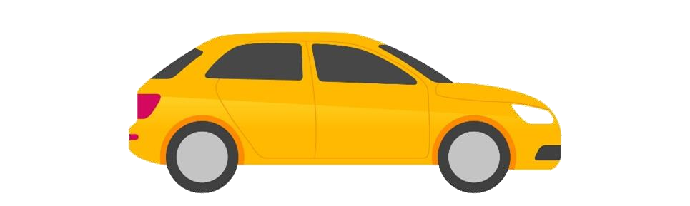
Introduction to Cloud Computing
Why Cloud Computing ? Benefits of Cloud Computing?
Own car
OLA
UBER
Private Car
Rental or Public car
Buying a car requires investment, driving ourselves or hiring a chauffeur, parking space and maintenance.
Cloud computing services such as Uber or Ola is like renting a car. No parking space required, no maintenance and you pay by miles.

Slide 12
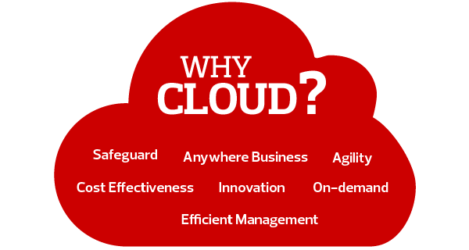
Introduction to Cloud Computing
Why Cloud?

Slide 13
Introduction to Cloud Computing
Why Cloud?
Cloud provides a host of benefits which make it so popular.
We can not only store large amounts of data securely on the cloud, but it is also possible to rent the latest hi-tech software and even hardware.
For example:
Consider that you are using a traditional method of computing in your office, now if your company recruits some more employees then you need to do all the hardware as well as software setup for all those employees again which will inevitably increase your expenses.
However, using cloud computing you get the platform on rent and simply provide the employees a terminal and credentials to logon to their virtual system. Hence, in this case you rent the processing time, memory and the software setup.
Whenever an employee quits, his resources are freed and there is no need to pay for those rentals.

Slide 14
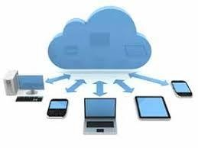
Introduction to Cloud Computing
Why Cloud?
The cloud itself is a set of hardware, networks, storage, services and interfaces that enable the delivery of computing as a service.
Cloud Computing – Definition:
Cloud Computing is the on-demand delivery of computer power, infrastructure, applications, storage and other IT resources through a cloud services platform via the internet with pay-as-you-go pricing.

Slide 15
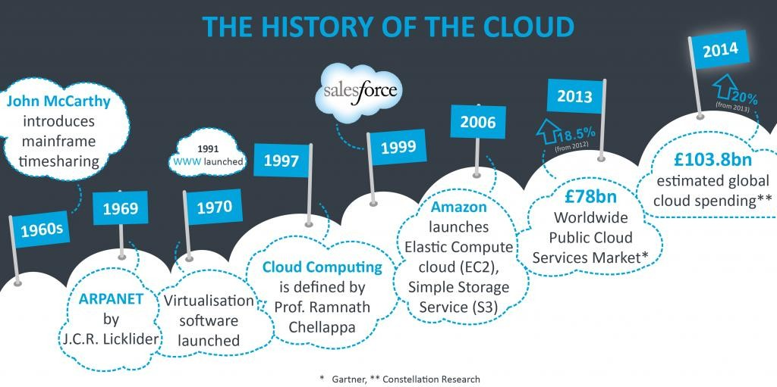
Introduction to Cloud Computing
History of Cloud Computing

Slide 16
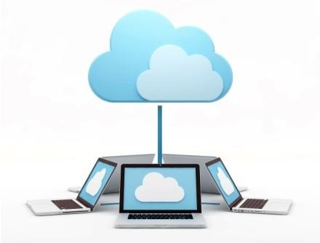
Introduction to Cloud Computing
History of Cloud Computing
The origin of cloud can be traced as far back as 1950s when John McCarthy, a computer scientist, introduced ‘theory of time sharing’.
In the 1960s, J.C.R. Licklider developed the ARPANET (Advanced Research Projects Agency Network) which formed the basis of today’s internet.
The development of virtual machines in 1970s enabled users to run multiple operating systems on a single machine.
In 1991, the World Wide Web emerged.

Slide 17
Introduction to Cloud Computing
History of Cloud Computing
The 1990s also saw a shift from point-to-point data circuits to virtual private network services being offered by telecommunication companies. This resulted in increased bandwidth at a lower cost.
In 1997, the first definition of cloud computing was given by Professor Ramnath Chellapa of Emory University. He defined Cloud Computing as,
‘Computing paradigm where the boundaries of computing will be determined by economic rationale rather than technical limits alone.’

Slide 18

Introduction to Cloud Computing
History of Cloud Computing
Major Milestones:
1999: Salesforce.com
Established the ability to use a simple website on the Internet to deliver enterprise-level applications.
2002: Amazon Web Services
Featured several cloud-based retail services which included data storage and computation.
2006: Amazon’s Elastic Compute Cloud (EC2) – the
first commercial cloud
Enabled small companies to rent computers that would host and run their own applications.

Slide 19
Introduction to Cloud Computing
History of Cloud Computing
Major Milestones:
2007: Dropbox
MIT student created this file-hosting service that offers file storage and synchronization.
2009:
Google Apps – example of browser-based enterprise applications
Windows Azure – Microsoft’s cloud computing platform

Slide 20
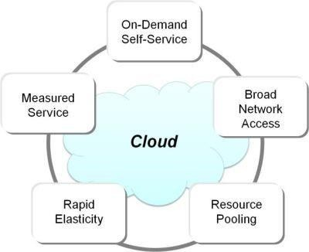
Introduction to Cloud Computing
Characteristics of Cloud Computing
On-demand Service
Broad Network Service
Resource Pooling
Rapid Elasticity
Measured Service

Slide 21
Introduction to Cloud Computing
Characteristics of Cloud Computing
On-demand Service: The user can provide the required resources automatically without human intervention.
Broad Network Access: Accessible from any of the consumer’s devices (such as Mobile, tablet, laptop and Desktop).
Resource Pooling: Multiple consumers can use multiple physical and virtual resources dynamically assigned and reassigned according to their demand.
Rapid Elasticity: Capabilities can be provisioned elastically. They can be scaled up and down based on the consumer’s demand.
Measured Service: The service is measured using the pay-as-you-go pricing model.

Slide 22
Introduction to Cloud Computing
Types of Cloud Services:
The major three categories are IaaS, PaaS and SaaS.
Infrastructure as a service (IaaS): The cloud provider provides IT infrastructure like the servers, virtual machines, storage, networks, and the operating systems on pay-as-you-go basis.
Platform as a service (PaaS): The developers may use the cloud computing services on demand for creating a web or mobile application. They need not worry about setting up the development environment.
Software as a service (SaaS): The users just connect to the Internet through phone, PC or the tablet and use the application hosted on cloud. The cloud service providers host and manage the software application, infrastructure, handle maintenance and upgrades including patching.

Slide 23
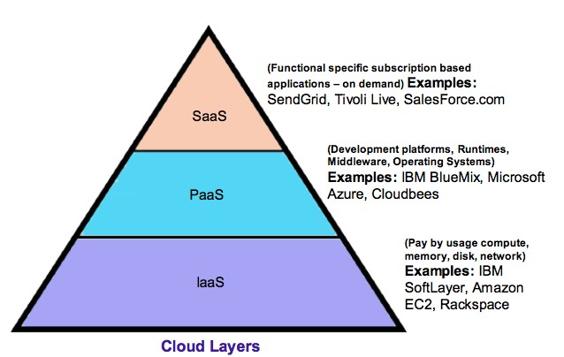
Introduction to Cloud Computing
The Three Major Cloud Services:

Slide 24
Introduction to Cloud Computing
Types of Cloud Services:
Other Cloud services:
Data as a service (DaaS): data are stored on cloud and made available to users on demand regardless of their geographic location.
Desktop as a service provides a virtual desktop.
Storage as a service (SaaS) provides data storage infrastructure.
Test environment as a service: we can rent a test setup to quickly test our application.
Security as a service (SECaaS): we can allow the cloud provider to take care of the security.
API as a service is a SaaS exposed as an API (Application Programming Interface). It allows users to access web services such as Google Maps, credit card processing and payroll processing.

Slide 25
Introduction to Cloud Computing
Cloud Computing Models

Slide 26
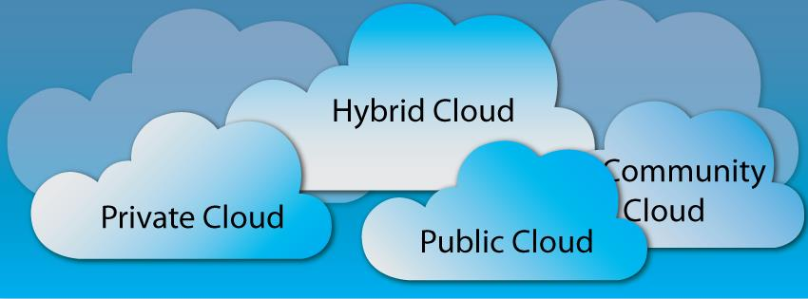
Introduction to Cloud Computing
Cloud Deployment Models:
National Institution of Standards and Technology (NIST) operate under the US Department of Commerce and has defined many of the key concepts used in cloud computing.
NIST Special Publication 800-145 identifies four models for cloud deployments. These are:
Public Cloud
Private Cloud
Community Cloud
Hybrid Cloud

Slide 27
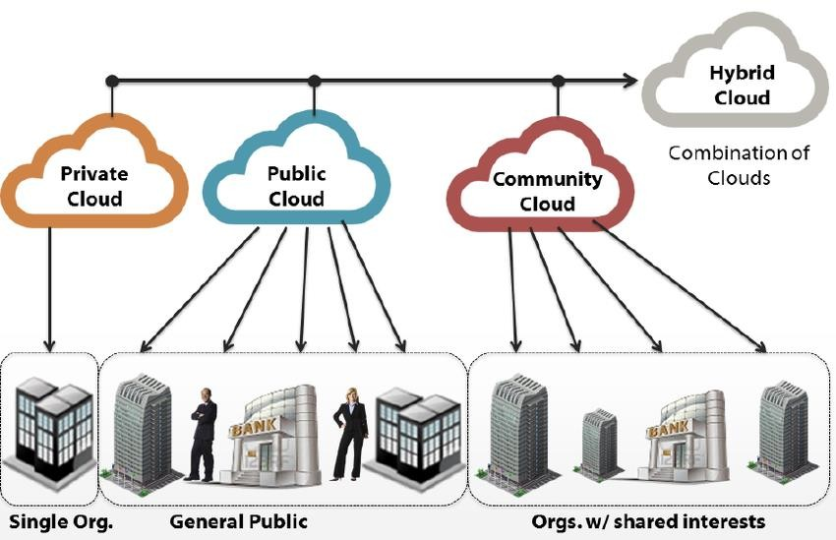
Introduction to Cloud Computing
Cloud Deployment Models:
Private cloud – owned organization
by a single
Public cloud – accessible to the public
Community cloud – shared by a group of organizations
Hybrid cloud – a combination of the above three clouds

Slide 28
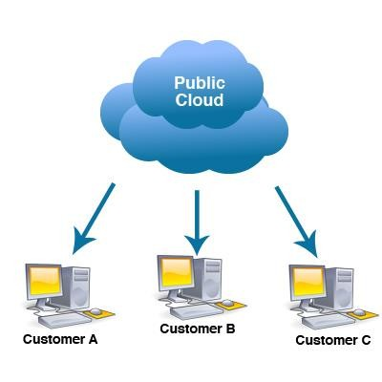
Introduction to Cloud Computing
Public Cloud
Public clouds are external publicly available environments accessible to multiple tenants.
The cloud provider is responsible for the creation and the on-going maintenance of the public cloud and its IT resources.
Public clouds are ideal for individuals, startups and other organizations with financial restrictions.

Slide 29
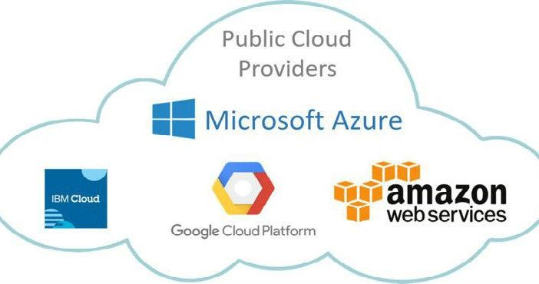
Introduction to Cloud Computing
Public Cloud
Some of the Public cloud examples include Amazon Web Services, Microsoft Azure, IBM Cloud and Google Cloud Platform.

Slide 30
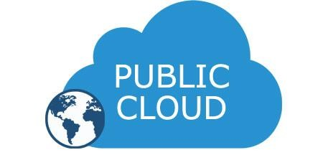
Introduction to Cloud Computing
The Case of Public Cloud
Consider this,
Connected Solutions is a startup venture started by four classmates who are interested in developing IoT (Internet of Things) solutions. However, when it comes to investing in infrastructure like storage and networking, finance is an issue. What would Connected Solutions do?
If you are limited in financial resources but still require a good amount of space to store your data, using a public cloud is the best option.
There are good public cloud pricing plans that offer good amount of storage.
Additionally, public clouds tend to use the latest technological advancements (hardware, software and so on), have better utilization rates, provide greater elasticity and continually test your applications and networks.

Slide 31
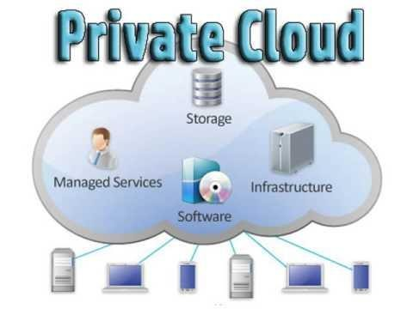
Introduction to Cloud Computing
Private Cloud
A Private Cloud is owned by a single organization.
Private cloud helps an organization in centralizing the access of IT resources by its various locations and departments.
Private clouds are ideal especially for organizations that have heavily invested in infrastructure.

Slide 32
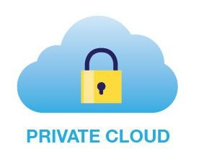
Introduction to Cloud Computing
The Case of Private Cloud
Consider this as an example,
You are a financial organization with a big infrastructure. You deal with sensitive information, hence, security is of utmost importance. You want your infrastructure to be centralized, secure and to have a greater control over it. What is your best option?
A private cloud though expensive, comes with greater security and control.
A private cloud is custom designed by you for your business.
It allows for rapid scaling of business operations.
And most importantly, when issues arise you can prioritize and handle them unlike a public cloud where the delays in resolving an issue may pile up.

Slide 33
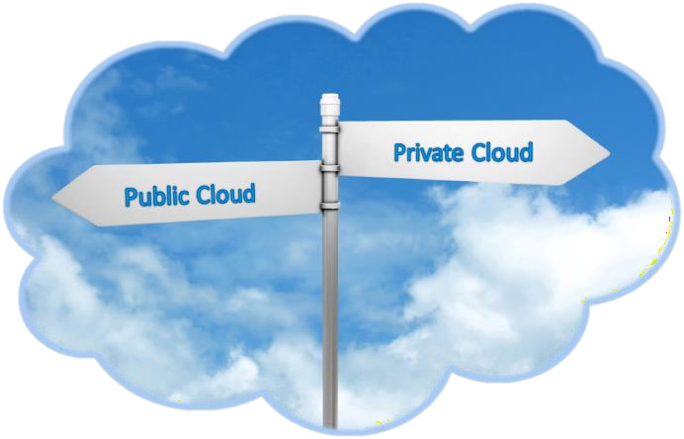
Introduction to Cloud Computing
Public Cloud vs. Private Cloud
Private clouds combine the security of keeping resources in- house with the scalability of the cloud by storing resources privately. Therefore, they are an ideal solution for companies with compliance requirements who cannot host their resources on a public cloud.
However, public clouds are best when facing financial restrictions and are not dealing with sensitive information.

Slide 34
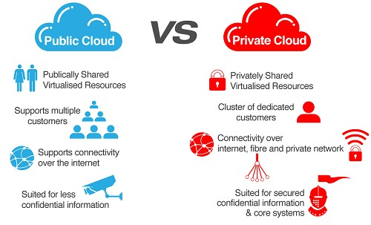
Introduction to Cloud Computing
Public Cloud vs. Private Cloud

Slide 35
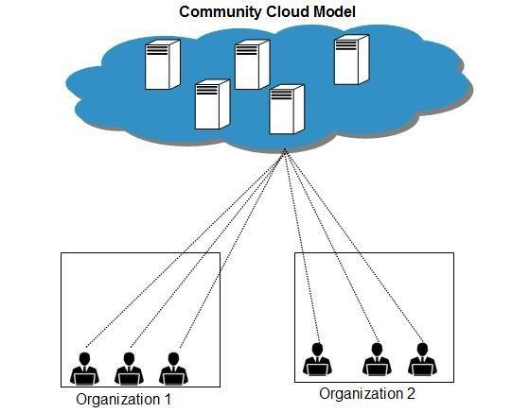
Introduction to Cloud Computing
Community Cloud
Community cloud model is shared by a group of organizations with similar requirements such as security, compliance and IT policies.
The community cloud may be jointly owned by the community members or by a third-party cloud provider that provisions a public cloud with limited access.

Slide 36
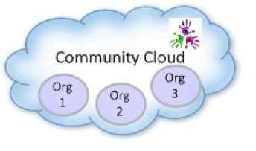
Introduction to Cloud Computing
The Case of Community Cloud
For example, the Department of Defense and some intelligence agencies have launched data centre improvement initiatives using a community cloud. This enables them to easily share data with other agencies in the community cloud, while still keeping it secure and controlled.
Another industry taking advantage of community clouds is the healthcare industry, where everyone in the community can support patients and exchange data in a controlled way.
Uses of community cloud:
Allows for easy sharing and collaboration
Lowers costs

Slide 37
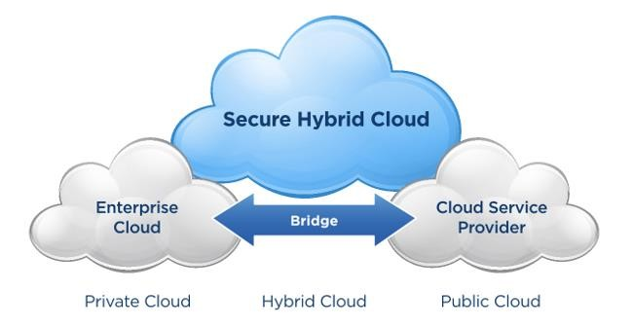
Introduction to Cloud Computing
Hybrid Cloud
Hybrid cloud is a combination of two or more models, private cloud, public cloud or community cloud.
For example, a cloud consumer may choose to deploy cloud services processing sensitive data to a private cloud and other less sensitive cloud services to a public cloud. The result of this combination is a hybrid deployment model.

Slide 38
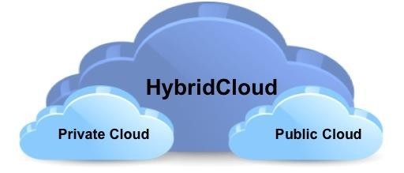
Introduction to Cloud Computing
The Case of Hybrid Cloud
Consider a business with dynamic work load that experiences significant hike in business during holiday season. They require more resources to handle the peak season. However, these resources are not required for the rest of the year. What would be the best option?
A hybrid cloud - A private cloud for off season operations and public cloud services for the holiday
season is an ideal combination for such a business.

Slide 39
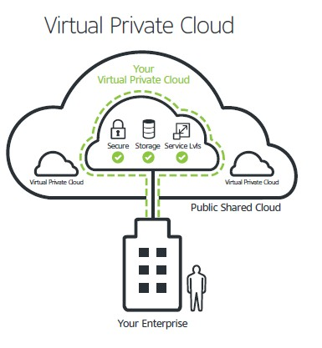
Introduction to Cloud Computing
Other Deployment Models:
There are other variations of the basic cloud deployment
models such as:
Virtual Private Cloud: also called ‘dedicated cloud’ or ‘hosted cloud’ is a self-contained cloud environment hosted and managed by a public cloud provider.

Slide 40
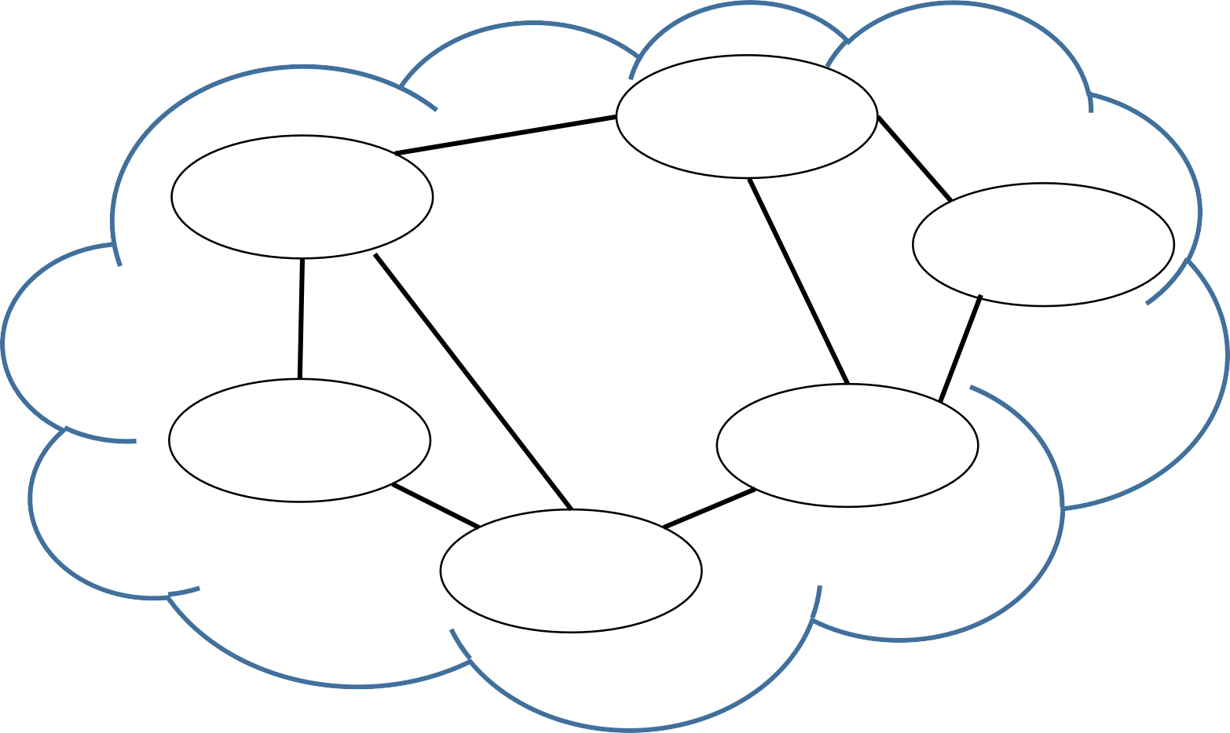
Introduction to Cloud Computing
Other Deployment Models:
Inter-Cloud: comprised of two or more interconnected clouds.
Salesforce
Google
Microsoft
Intercloud
Zoho
Amazon
Yahoo

Slide 41
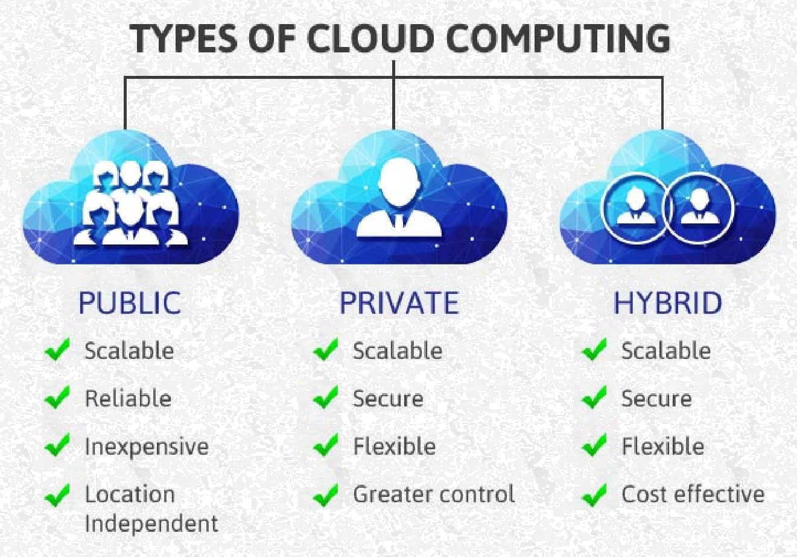
Introduction to Cloud Computing
Advantages of Cloud Computing Models:

Slide 42
Introduction to Cloud Computing
Advantages of Cloud Computing
Cost Efficient – the pay-as-you-go model significantly minimizes the organization’s costs.
Almost Unlimited Storage – Using cloud storage means unlimited storage capability. No running out of storage or no need of investing in storage devices.
Backup and Recovery – all the data are backed up on to the cloud. Hence, backup and recovery becomes more easier.
Automatic Software Integration – the changes to the software made by different developers are tested and integrated several times in a day. This is automatically done when using cloud.
Easy Access to Information – once registered, information can be accessed from any location and from any device.
6. Quick Deployment – using cloud you can get your entire system fully functioning in just a couple
of minutes.
42

Slide 43
Introduction to Cloud Computing
Disadvantages of Cloud Computing:
Technical issues:
Though cloud enables you to access information from anywhere and on any device, however, the system can sometimes malfunction and besides that you also need a strong internet connection.
Security in Cloud:
You should always be careful to choose the most reliable service provider since the company’s sensitive information is being handed over to a third party for storage.
Prone to Attack:
Storing information in the cloud makes it accessible to hackers.

Slide 44
Introduction to Cloud Computing
Evolution of Data Centres

Slide 45
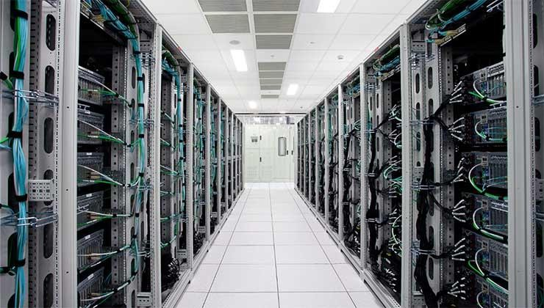
Introduction to Cloud Computing
What is a Data Centre?
A data centre is a repository that houses computing facilities like servers, routers, switches and firewalls, as well as supporting components like backup equipment, fire suppression facilities and air conditioning.
A data centre can be either complex (dedicated building) or
simple (an area or room that houses only a few servers). Additionally, a data centre can be either private or shared.

Slide 46

Introduction to Cloud Computing
Components of a Data Centre:
A data centre may include:
Servers
Computers
Networking equipment such as routers or switches
Security such as firewall or biometric security system
Storage such as storage area network (SAN) or backup/tape
storage
Data centre management software/applications
It can also include non-computing resources, such as:
Power and cooling devices such as air conditioners or
generators
Physical server racks/chassis
Cables
Internet backbone

Slide 47
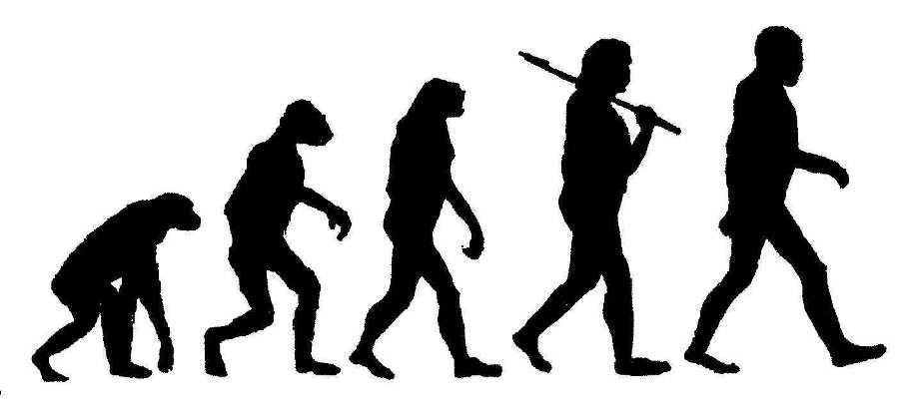
Introduction to Cloud Computing
Evolution of Data Centres:
Today’s Cloud is an extension of data centres.
When we examine the evolution of traditional data centre infrastructure into the cloud, the journey starts with server virtualization and moves through privately hosted and hybrid clouds into fully public cloud infrastructures with all elements virtualized.
47

Slide 48
Introduction to Cloud Computing
Evolution of Data Centres:
Increased Virtualization
Traditional Data Centre
Server Virtualization
Distributed Virtualization
Private Clouds
Hybrid Clouds
Public Clouds
Capital Expenses
Operational Expenses
Going from physical traditional data centres to increasingly virtualized IT infrastructures in the cloud
47

Slide 49
Introduction to Cloud Computing
Server Virtualization:
Server virtualization allows organizations to concentrate their data centre resources across a
smaller number of physical hosts.
Distributed Virtualization:
Extending the virtualization to include distributed resources using technologies that can transfer
operations between automated systems.
Private Clouds:
This is the first true transformation from traditional data centre resources to cloud-based alternatives, enhancing the flexibility of resource assignment while still relying on local server resources.

Slide 50
Introduction to Cloud Computing
Hybrid Clouds:
The private clouds can be bridged with other cloud offerings to create hybrid clouds, extending the
resource pool beyond the systems present in local data centres.
Public Clouds:
The organizations move to eliminate private cloud components in favor of externally provided public cloud environments. The data centre continues to empty and IT expands becomes a business component with a smaller dedicated server support staff required for daily operations.

Slide 51
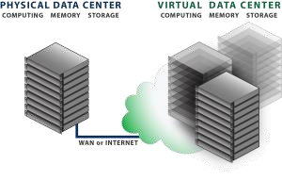
Introduction to Cloud Computing
Virtual Data Centre on the Cloud
A Virtual Data Centre is a remote located pool of computing, memory and storage resources that your company can use on demand to reduce the need for complex IT investments.
You simply rent the resources you need for longer and shorter periods of time.
A software is used to administer the resources and roll them out to your departments in need of computing power. This is a software-defined data centre.

Slide 52

Introduction to Cloud Computing
Evolution of a Data Centre into Private Cloud:
The first evolution phase is consolidation and aggregation of assets in a data centre (Traditional data centre).
The second phase is abstraction of the data centre assets from the services that it provides using virtualization technologies (Virtual Data centres).
The third phase is automating the process of provisioning the services.
The fourth phase is the ‘enterprise class cloud’. Here the cloud computing concepts are implemented and IT services are delivered as a utility.

Slide 53
Introduction to Cloud Computing
Self Assessment Question
Cloud enables the delivery of:
Computing as a service
Software as a service
Answer: Computing as a service

Slide 54
Introduction to Cloud Computing
Self Assessment Question
Cloud Computing is:
A pay all service
A pay-as-you-go service
Answer: A pay-as-you-go service

Slide 55
Introduction to Cloud Computing
Self Assessment Question
The concept of in mainframes forms the basis of cloud computing.
Distributed systems
Time sharing
Answer: Time sharing

Slide 56
Introduction to Cloud Computing
Self Assessment Question
On-demand service means:.
User can provide the required resources automatically without human intervention.
User can provide the required resources manually without human intervention.
Answer: User can provide the required resources automatically without human intervention.

Slide 57
Introduction to Cloud Computing
Self Assessment Question
Which of the given option is not specified by NIST:
Private Cloud.
Public Cloud
Hyper Cloud
Hybrid Cloud
Answer: Hyper Cloud

Slide 58
Introduction to Cloud Computing
Self Assessment Question
is an externally available environment accessed by multiple tenants.
Private Cloud.
Public Cloud
Community Cloud
Hybrid Cloud
Answer: Public Cloud

Slide 59
Introduction to Cloud Computing
Self Assessment Question
A private cloud is:.
Owned by a single organization
Owned by a single person
Answer: Owned by a single organization

Slide 60
Introduction to Cloud Computing
Self Assessment Question
XYZ Company maintains a private cloud; however, it uses the public cloud services during peak
times. What is their cloud deployment model?
Community Cloud
Hybrid Cloud
Answer: Hybrid Cloud

Slide 61
Introduction to Cloud Computing
Self Assessment Question
A group of companies share similar IT policies. Which cloud deployment model would you suggest
they use?
Private Cloud
Community Cloud
Answer: Community Cloud

Slide 62
Introduction to Cloud Computing
Self Assessment Question
is a deployment model that connects two or more clouds.
Inter-cloud
Composite cloud
Answer: Inter-cloud

Slide 63
Introduction to Cloud Computing
Self Assessment Question
Cloud enables users to access their data from any location and any device..
True
False
Answer: True

Slide 64
Introduction to Cloud Computing
Self Assessment Question
Cloud supports:
Manual software integration
Automatic software integration
Answer: Automatic software integration

Slide 65
Introduction to Cloud Computing
Self Assessment Question
Cloud has strong security. You can put all your confidential information on the cloud.
True
False
Answer: False

Slide 66
Introduction to Cloud Computing
Self Assessment Question
Cloud data is prone to attack.
True
False
Answer: True

Slide 67
Introduction to Cloud Computing
Self Assessment Question
A data centre is:
A repository that houses computing facilities like servers, routers, switches and firewalls, as well as supporting components.
A repository to store databases
Answer: A repository that houses computing facilities like servers, routers, switches and firewalls, as well as supporting components.

Slide 68
Introduction to Cloud Computing
Self Assessment Question
Cables and cooling devices cannot be considered as components of a data centre.
Yes
No
Answer: No

Slide 69

Introduction to Cloud Computing
Document Links
Topics | URL | Notes
Cloud Computing | https://aws.amazon.com/what-is-cloud- computing/ | This link explains the basics of cloud computing including its advantages.
History of Cloud Computing | https://cloudcomputing521.wordpress.c om/2017/05/01/history-of-cloud- computing/ | This link explains the origin and evolution of cloud computing.
Cloud Deployment Models | http://whatiscloud.com/cloud_deploym ent_models/index | It contains links explaining Private, Public, Community, Hybrid and other deployment models for cloud.
Evolution of Data Centres | https://www.cisco.com/c/dam/en_us/so lutions/industries/docs/gov/CiscoClou dComputing_WP.pdf | This link explains the phases involved in the evolution of a traditional data centre into a private cloud.

Slide 70

Introduction to Cloud Computing
Video Links
Topics | URL | Notes
Cloud Computing | https://www.youtube.com/watch?v=QJ ncFirhjPg | Gives an overview about cloud computing
History of Cloud Computing | https://www.youtube.com/watch?v=vw 1ip87CLVU | Gives a brief history of cloud computing.
Cloud Deployment Models | https://www.youtube.com/watch?v=Qk 5y--YQnOw | Explains the four major cloud deployment models - private, public, hybrid and community.

Slide 71
Introduction to Cloud Computing
Extracting Business Value in Cloud Computing

Slide 72
Introduction to Cloud Computing
Cloud for Business
For most businesses, IT has become a necessity.
Hosting IT services in-house can be costly and distract businesses from focusing on their core competencies.
As such, IT is becoming less about acquiring the right equipment and more about acquiring the right
services.
The business drivers for cloud are:
Cloud scalability
Cloud Security
Increasing Organizational agility

Slide 73
Introduction to Cloud Computing
Cloud Scalability
Scalability, also called flexibility or elasticity, is a key characteristic of cloud computing.
It allows customers to increase or decrease computing resources, such as storage, computing power and network bandwidth dynamically, based on their need and the amount the customer is willing to pay.
Scaling can be either vertical (scaling up) or horizontal (scaling out).
Vertical scaling involves adding resources to a single node such as memory, processing power or redundant components.
Horizontal scaling involves adding more nodes to a distributed system.

Slide 74
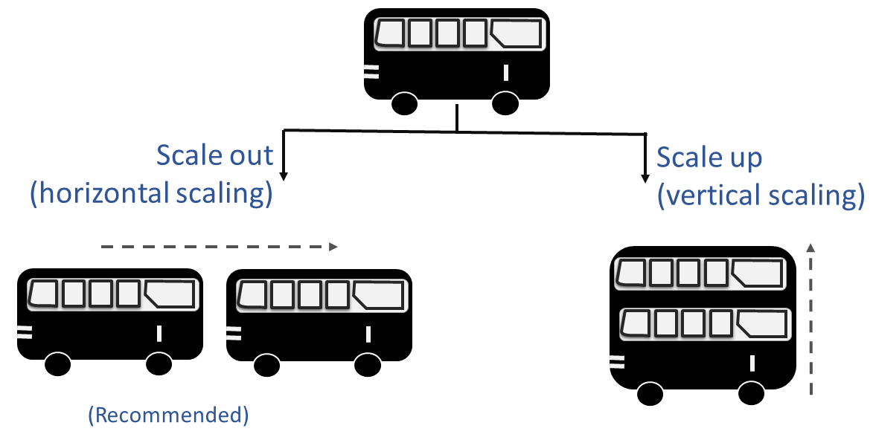
Introduction to Cloud Computing
Cloud Scalability

Slide 75
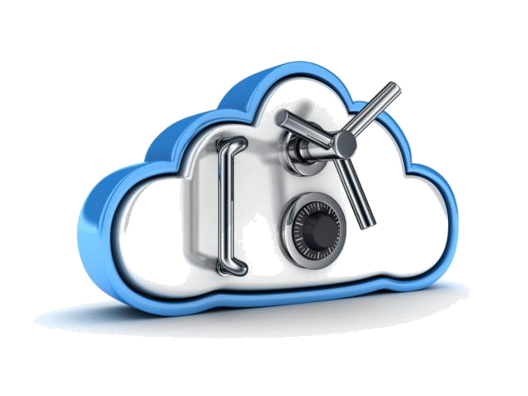
Introduction to Cloud Computing
Cloud Security
Cloud computing can provide some benefit to security through economies of scale. Cloud service providers may potentially provide a greater level of security than an organization could on its own by spreading the cost across its customer base.
The following are some examples of security benefits:
Increased availability and improved disaster recovery through redundancy and multiple locations
Security specialists
24/7 staffing and monitoring

Slide 76

Introduction to Cloud Computing
Increasing Organizational Agility
Organizational agility is the ability to rapidly adapt to changes in the market or industry through identification and realization of opportunities.
Cloud computing allows organizations to focus more on their core business activities and less on maintaining an IT environment.

Slide 77


Introduction to Cloud Computing
Increasing Organizational Agility
The following are some examples of how organizational agility is facilitated by cloud computing:
Shortened Time to Market
A combination of self-service provisioning of resources and a pay-as-you-go billing model allows organizations to rapidly develop new products (particularly applications or web-based services) without being limited by the cost of computing hardware or being stalled by long procurement time.
Rapid development

Slide 78

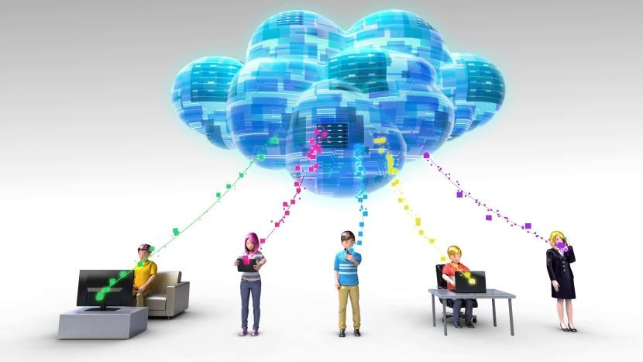
Introduction to Cloud Computing
Increasing Organizational Agility
Mobility
Global access to organizational enterprise resources is required for organizations with a distributed workforce. Because cloud- based applications are distributed over the Internet and accessed via a web browser, they are easily accessed by various types of mobile devices.

Slide 79
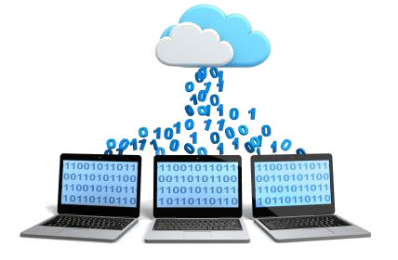
Introduction to Cloud Computing
Moving to Cloud
Before moving the IT operations to the cloud a business should consider the following steps:
Evaluate cloud computing costs.
Identify the value to your organization now and in the future.
Choose an appropriate cloud model.

Slide 80

Introduction to Cloud Computing
Evaluate cloud computing costs
It is essential to calculate the Total Cost of Ownership (TCO).
TCO is the complete cost of an object or service throughout its lifetime, from purchase to disposal, including both direct and indirect costs.
The TCO for cloud services must be compared with the TCO of handling the same services in-house before opting for cloud services.
Besides, the TCO of an on-premise cloud deployment model will be higher than an external private cloud service managed by a service provider.

Slide 81

Introduction to Cloud Computing
Determine Return on Investment
Return on investment (ROI) is a performance measure used to evaluate investment efficiency or compare multiple investments.
It is calculated by dividing the benefit of the investment (net gain or loss) by the cost of the investment.
The greater the ROI, the better the investment.
The formula is as follows:
ROI = (benefit – investment cost) / (investment cost)

Slide 82

Introduction to Cloud Computing
Determine Return on Investment
Company XYZ is trying to decide whether it should invest in a
new SAN or utilize cloud storage.
Factors going into the benefit of cloud storage might include the reduced capital investment, reduction in administrative overhead and reduced power costs in the in-house data centre.
The investment cost would include both the up-front costs and the subscription cost for a set period of time.
Using the ROI formula, you can determine how long it will
take to break even (0 ROI) and to see value (positive ROI).
A negative ROI indicates that it will cost the organization money.

Slide 83

Introduction to Cloud Computing
Choosing the Appropriate Cloud Model
Choosing the appropriate model is a critical decision that will impact planning,
cost, and business processes at a minimum.
Public clouds:
Startups and small businesses and those with variable need of resources.
Private clouds:
For businesses which already have invested big time in IT infrastructure, private cloud can help use it more efficiently and have greater control over the data.
Hybrid clouds:
Hybrid clouds are suitable for businesses that generally would benefit from private cloud services but occasionally have periods of high demand. During these high-demand times, public cloud resources can be used.
100

Slide 84
Introduction to Cloud Computing
Cloud Computing Case Studies
100

Slide 85
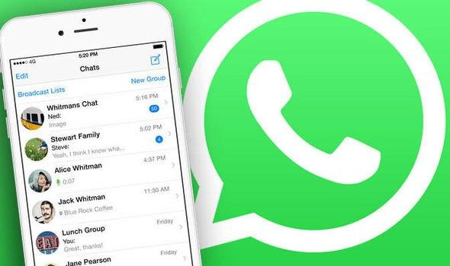
Introduction to Cloud Computing
Case Study I
WhatsApp (hosted on IBM Softlayer)
WhatsApp started as an inexpensive messaging service to link people over internet. However, in a short period of time it became a huge success and a messaging giant.
100

Slide 86
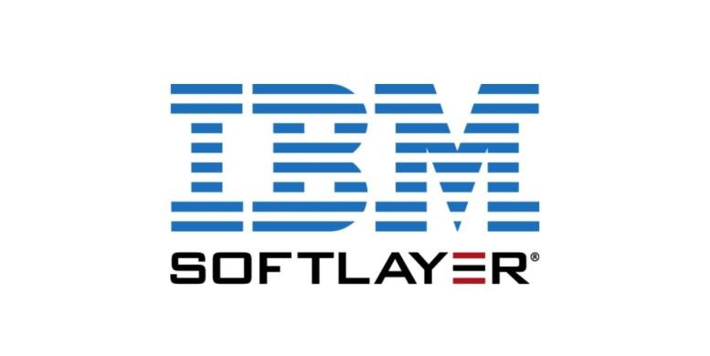
Introduction to Cloud Computing
Case Study I
Case Scenario:
At the beginning, WhatsApp had 50 million users. This number grew to 200 million by third year of its operation and doubled in the next year and reached more than 400 million users. The ever growing numbers of users was a real challenge for WhatsApp. The messaging giant made top news in 2014 when Facebook announced it would acquire WhatsApp for a whopping $19 billion.
Solution:
The Company turned to IBM Softlayer to find unique platform as a service capabilities which could connect its app and data to the cloud and manage exponential growth in its users.
100

Slide 87
Introduction to Cloud Computing
Case Study I
WhatsApp (hosted on IBM Softlayer)
Benefits:
Exchange of data can be done on the cloud.
Developers do not need to spend time on database management.
With this platform, they can extend the app’s capabilities and include a wide variety of both structured and unstructured data.
The application can be accessed 24/7 and can be scaled to massive volumes of networks, users and devices.
100

Slide 88
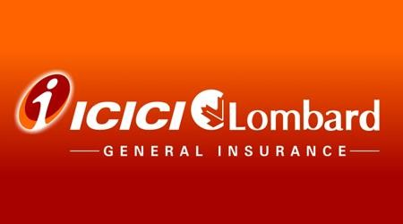
Introduction to Cloud Computing
Case Study II
ICICI Lombard (hosted on Microsoft Azure)
ICICI Lombard lays its expansion plans by leveraging the power of public cloud with no compromise on security.
100

Slide 89
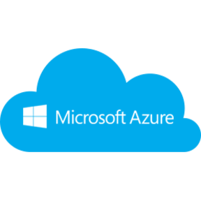
Introduction to Cloud Computing
Case Study II
ICICI Lombard (hosted on Microsoft Azure)
Case Scenario:
As ICICI Lombard was moving towards a more customer centric approach with cutting edge technology, there was one unsolved mystery to be tackled, ‘How to handle applications with peak times that are exponentially higher than the average?’ Provisioning and de-provisioning of servers based on these varying peak loads caused time, cost and resource pressures on the organization.
Solution:
ICICI Lombard turned to Microsoft Azure to manage the IT infrastructure for applications like email systems and storage. The constant technical support and the matured security measures offered by Azure enabled the client to move more complex applications to the cloud.
100

Slide 90
Introduction to Cloud Computing
Case Study II
ICICI Lombard (hosted on Microsoft Azure)
Benefits:
ICICI Lombard now enjoys automated management of the platform and applications, thus reducing the cost and time considerably.
More than 30 UAT servers have been decommissioned after a batch of 17 applications were moved to the cloud.
With more non-production applications being hosted on the Azure cloud, the time-to-market has been enhanced, and more maturity is observed in SDLC.
100

Slide 91

Introduction to Cloud Computing
Case Study III
Expedia (hosted on Amazon)
Expedia partners with Amazon Web Services (AWS) to enhance online customer experience.
100

Slide 92

Introduction to Cloud Computing
Case Study III
Expedia (hosted on Amazon)
Case Scenario:
Expedia is the largest online travel brand that includes several travel and hospitality platforms such as Expedia.com, Hotwire.com, Hotels.com and so on. It acts as the ultimate bridge between consumers and the travel industry in several countries. In 2010, Expedia launched the Expedia Suggest Service (ESS) that assists travellers to enter their travel information accurately. Delivering the maximum level of responsiveness with minimal network latency were the biggest challenges of ESS.
Solution:
The cloud expertise offered by AWS enabled Expedia to build ESS in only 3 months. The service was launched initially in Singapore and after tasting success it was quickly replicated across regions in the United States and Europe. The average network latency was reduced from almost 700 ms to just 50 ms by hosting the high- volume, critical ESS on AWS cloud.
100

Slide 93
Introduction to Cloud Computing
Case Study II
Expedia (hosted on Amazon)
Benefits:
Enhanced online customer experience through reduced errors and
increased speed.
Reduced costs by eliminating the need to run the service full- fledged across locations closer to the customers.
Increased availability of the service with easier troubleshooting of
issues.
100

Slide 94
Introduction to Cloud Computing
Self Assessment Question
Scalability allows:
Customers to increase computing resources dynamically.
Customers to increase or decrease computing resources dynamically.
Answer: Customers to increase or decrease computing resources dynamically
100

Slide 95
Introduction to Cloud Computing
Self Assessment Question
If we add more processors to an existing server, it is called:
Horizontal scalability.
Vertical scalability
Answer: Vertical scalability
100

Slide 96
Introduction to Cloud Computing
Self Assessment Question
Horizontal scalability is
Adding more nodes.
Adding resources to a single node.
Answer: Adding more nodes.
100

Slide 97
Introduction to Cloud Computing
Self Assessment Question
Organizational agility is
The ability to rapidly adapt to changes.
Preparing for the uncertainties.
Answer: The ability to rapidly adapt to changes.
100

Slide 98
Introduction to Cloud Computing
Self Assessment Question
What characteristic of cloud computing reduces administrative costs?
Self-service or automated resource management
Limitation of platform/application development selection (in PaaS environments)
Placing the cloud data centre farther away from local administrators
Paying only for resources actually consumed
Answer: Paying only for resources actually consumed
100

Slide 99
Introduction to Cloud Computing
Self Assessment Question
Decreased time to market is facilitated by which of the following cloud computing benefits?
Economies of scale
Mobility
Pay-as-you-go billing
Disaster recovery
Answer: Pay-as-you-go billing
100

Slide 100
Introduction to Cloud Computing
Self Assessment Question
Cloud computing is ideal for an organization with a distributed work force.
True
False
Answer: True
100

Slide 101
Introduction to Cloud Computing
Self Assessment Question
The Total Cost of Ownership is:
The cost of purchase of an object including the taxes.
The complete cost of an object or service throughout its lifetime, from purchase to disposal.
Answer: The complete cost of an object or service throughout its lifetime, from purchase to disposal.
100

Slide 102
Introduction to Cloud Computing
Self Assessment Question
A startup business should opt for:
Public cloud deployment
Private cloud deployment
Answer: Public cloud deployment
100

Slide 103
Introduction to Cloud Computing
Assignment
You need to answer the below sets of problem. These sets of questions are meant for testing unit I.
Define cloud computing and list the characteristics of cloud computing.
Explain the history of cloud computing.
Compare the advantages and disadvantages of cloud computing.
Explain cloud deployment models.
Explain the various phases in the evolution of datacentre into public cloud.
Define cloud scalability. Compare horizontal and vertical scalability using an example.
Elaborate on cloud security.
A group of college freshers have a well-thought business idea. They want to start a SMB (Small Medium-sized Business) at a budget (preferably on a pay-as-you-go basis) but with as much less overhead of maintaining the infrastructure as possible. Which cloud deployment model would be suitable here?
100

Slide 104
Introduction to Cloud Computing
Summary
Cloud computing is the on-demand delivery of computer power, infrastructure, applications, storage and other IT resources through a cloud services platform via the internet with pay-as-you-go pricing.
Public clouds are external, publicly available environments accessible to multiple tenants.
A private cloud is owned by a single organization.
Community cloud model is shared by a group of organizations with similar requirements such as security,
compliance and IT policies.
Hybrid cloud is a combination of two or more models, private cloud, public cloud or community cloud.
A data centre is a repository that houses computing facilities like servers, routers, switches and firewalls, as well as supporting components like backup equipment, fire suppression facilities and air conditioning.
Cloud scalability allows customers to increase or decrease computing resources such as storage, computing power, and network bandwidth dynamically, based on their need and the amount the customer is willing to pay.
Total Cost of Ownership (TCO) is the complete cost of an object or service throughout its lifetime, from
purchase to disposal, including both direct and indirect costs.
104

Slide 105
Introduction to Cloud Computing
Document Links
Topics | URL | Notes
Cloud Computing | https://aws.amazon.com/what-is-cloud-computing/ | This link explains the basics of cloud computing including its advantages.
History of Cloud Computing | https://cloudcomputing521.wordpress.com/2017/0 5/01/history-of-cloud-computing/ | This link explains the origin and evolution of cloud computing.
Cloud Deployment Models | http://whatiscloud.com/cloud_deployment_models /index | It contains links explaining Private, Public, Community, Hybrid and other deployment models for cloud.
Evolution of Data Centres | https://www.cisco.com/c/dam/en_us/solutions/ind ustries/docs/gov/CiscoCloudComputing_WP.pdf | This link explains the phases involved in the evolution of a traditional data centre into a private cloud.
Cloud for Business | https://www.business.qld.gov.au/running- business/it/cloud-computing/benefits | The link explains the benefits of using cloud for businesses.
Cloud Scalability | https://www.cloudassessments.com/blog/scalabilit y-cloud-computing/ | The link explains vertical and horizontal scalability and the benefits of scalability.
Cloud Security | https://aws.amazon.com/security/introduction-to- cloud-security/ | The link explains cloud security.
105

Slide 106
Introduction to Cloud Computing
Video Links
Topics | URL | Notes
Cloud Computing | https://www.youtube.com/watch?v=QJncFirhjPg | Gives an overview about cloud computing
History of Cloud Computing | https://www.youtube.com/watch?v=vw1ip87CLV U | Gives a brief history of cloud computing.
Cloud Deployment Models | https://www.youtube.com/watch?v=Qk5y-- YQnOw | Explains the four major cloud deployment models - private, public, hybrid and community.
Cloud for Business | https://www.youtube.com/watch?v=KVydGQGR1 Lo | The link explains the pros and cons of cloud computing to understand the difference between on-premise computing and cloud computing.
Cloud Scalability | https://www.cloudassessments.com/blog/scalabilit y-cloud-computing/ | The video explains vertical and horizontal scalability and the benefits of scalability.
Cloud Security | https://www.youtube.com/watch?v=L-cC-JjYos0 | Explains cloud security using a use case.
105

Slide 107
Introduction to Cloud Computing
E-Book Links
Topics | URL | Page Number
Cloud Computing and its need | http://www.nortonaudio.com/Ficheiros/111840873X_Cloud.pdf | Page 1 to 5
Evolution of Data Centres | http://www.nortonaudio.com/Ficheiros/111840873X_Cloud.pdf | Page 15-18
Cloud Deployment Models | http://www.nortonaudio.com/Ficheiros/111840873X_Cloud.pdf | Page 21- 23
Cloud for Business | http://www.nortonaudio.com/Ficheiros/111840873X_Cloud.pdf | Page 75 - 83
105

